Slide 1
Computer Principles for Programmers
User Interfaces, PowerShell, and Time Management

Slide 2
News of the Week

Slide 3
Agenda: Lecture
What is “Command Line Interface” (CLI)? What is “Graphical User Interface” (GUI)?
Human Computer Interaction: from simple User Interfaces to the User eXperience CLI → TUI → GUI → UX
Introducing PowerShell as the new Windows CLI
Time Management

Slide 4
Agenda: Activity
Activity:
Introduction to Windows PowerShell command line
Time Management
A day without my phone is like…
Just kidding. I have no idea.
Notes:
https://www.bakadesuyo.com/2019/09/stop-checking-your-phone/

Slide 5
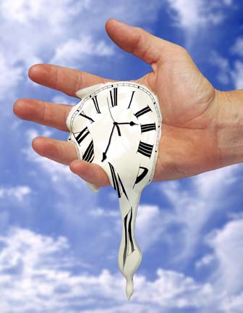
Time Management … do it first
The cost of anything is the amount of life you exchange for it. – Henry David Thoreau
Notes:
Appropriately, we are doing this topic first. Yes, it was last on the agenda but that’s the whole problem with time management: we leave it to the end when there isn’t enough time. By the mid-point of the term, most of us have discovered we don't have enough time so it is about time we looked at this. We say Time Management but time cannot be managed. You cannot be in charge of time, or control it, or order it around.
How is it that time and time again we don't have time? We do too many things at the same time yet want to do it right the first time, find ourselves working against time…and all these things happen all the time. Where does the time go? In 29BCE, Virgil wrote Tempus Fugit; Time has been fleeing since the dawn of time. We wish we had time to make the time, find the time to put in the time, we want to be ahead of our time not behind the times, we don’t want to get old before our time. We always need more time, wonder why we waste time while we are passing the time. The best time to run out of time is when you are having a bad time. See https://en.oxforddictionaries.com/definition/time
Only musicians "keep time" and then it's only the drummer and bass player. Time is money, but, unlike money, you cannot actually run out of time. Rich or poor, wise or foolish, old or young, lazy or hardworking, everyone gets 24 hours, replenished daily. Time is not something we have, time is something we are given. Time is a choice we make. Having no time is a message about something else. We don’t have a time management problem, we have an attention management problem.
Smartphones Are the New Cigarettes – https://markmanson.net/smartphones
————
Nobody is too busy, it’s just a matter of priorities. "I didn't have time." This really means it wasn't important enough, it wasn't a high priority, fun, distracting, profitable, or urgent enough to make it to the top of the list.
Every few days, Twitter and Facebook soak up a billion hours of 'spare' time. Where did that time come from? What did we do before social media was here? Weren't we busy before 2007?
http://sethgodin.typepad.com/seths_blog/2014/04/i-didnt-have-time.html
http://www.bakadesuyo.com/2017/03/how-to-stop-checking-your-phone/
James Gleik: "Recognize that neither technology nor efficiency can acquire more time for you, because time is not a thing you have lost. It is not a thing you ever had." "You can't waste time and you can't save time; you can only choose what you do at any given moment." from “James Gleick's Survival Lessons” in Wired 7.08 http://archive.wired.com/wired/archive/7.08/gleick.html
the actual Thoreau quote is “…the cost of a thing is the amount of what I will call life which is required to be exchanged for it, immediately or in the long run,” Walden, “Economy”

Slide 6
Stacks versus Queues
Email, To Do Lists
Calendar, Project Plan
Push
Pop
enqueue
3
2
1
3 | 2 | 1
dequeue
LIFO stacks deal with the immediate.
FIFO queues deal with the important.
Notes:
To do lists and your Inbox are a stack, Last In, First Out. Stacks deal with the immediate. Emails more than a week old may never be answered. You know how it goes: the day began beautifully, then…people.
The problem is not the few seconds you take to check your phone's notifications (you are right about that), the real problem is the many minutes it will take to reload your working memory and get your focus back to the interrupted task. This is an attention management problem.
The calendar schedule and project plan is a queue: First In, First Out. Queues deal with the important activities that are planned and scheduled. The passage of time conveniently organizes your queue but only if you schedule your to-do list tasks and follow the schedule. Nobody ever looked at an empty calendar and said, "The best way to spend this time is by cramming it full of meetings!" or got up in the morning and thought, Today I'll spend hours on my phone reading and posting to social media, and then YouTube or Netflix to rest my thumbs!
Yet that's what we do. So, start with making time for the most important things in your life: celebrating a birthday or anniversary, calling your mother (you know you should do this more often), dinner with your family, a movie with your partner, visiting with friends, and downtime for yourself. Putting everything you must do into your calendar reduces "memory load", the active process of keeping something "in mind" so you don't forget it. The memory load of "I can't forget to do this" reduces your capacity to think and increases your anxiety of forgetting it. Putting 'love to do' items in your calendar gives you a goal to work toward. Putting 'must do' items in your calendar gives you the opportunity to focus and get those things done.
This is time management. What choice will you make for the time blocks in your calendar? No one plans to fail. People fail one mark at a time. Erosion: Marks you can afford to lose, turns into Catastrophe: Marks you can't get back.
Scheduling a task means estimating time for something you may never have done before. Make your best guess. The more your guesses are wrong today, the less they will be wrong tomorrow.
Standard estimation for programming tasks: most realistic and honest estimate (includes coffee input, coffee output, breaks, and distractions) × 2 (for experts) to 4 (for the rest of us). That's total time spent on task.
See also http://eisenhower-matrix.com/ -- The 2 X 2 matrix of urgent/not and important/not
http://eisenhower-matrix.com/first-things-first/ – Steven Covey's version
https://www.google.ca/search?q=eisenhower+covey or https://www.google.ca/search?q=eisenhower+matrix+covey

Slide 7
Attention Management
EAT the FROG
in the MORNING
Notes:
This comes from a Mark Twain quote: “Eat a live frog first thing in the morning and nothing worse will happen to you the rest of the day.”
Do the task that is the most distasteful, the most difficult, the least appealing to you first thing in the morning…and you won't have to look forward to it all day long. It will also get done.
Handling distractions: when an interesting thought enters your head, take a moment to write it down (pen and paper). Handling unavoidable interruptions: take a few moments to write out your current thought (pen and paper) to bookmark your place in the interrupted task. Your brain, motivation, will power, and emotion can relax: you won't forget. Now, get back to what you were doing.
Redefine wealth and value as time and attention, and success becomes using time effectively and being intentional with our focus. Very successful people often spend their first work hours away from the distractions of the office, email, smartphones, and the Internet to focus only on their most important task for the day—then they go to the office and interact with the world.
Frogs are not only for breakfast… come to class. Students who pass are the ones who come to class; the ones who don't, don't. Coming to class is the result, the outward action, of self-regulated learners. see http://mathedseminar.pbworks.com/w/file/fetch/94760840/Zimmerman%20-%202002%20-%20Becoming%20a%20Self-Regulated%20Learner%20An%20Overview.pdf just come to class.
Procrastination: It's pretty much all in the mind https://www.bbc.com/news/health-45295392
Starting Your Day on the Internet Is Damaging Your Brain https://getpocket.com/explore/item/starting-your-day-on-the-internet-is-damaging-your-brain https://www.realsimple.com/work-life/life-strategies/time-management/procrastination
https://www.psychologytoday.com/ca/blog/brain-wise/201209/the-true-cost-multi-tasking
https://www.theverge.com/2017/1/31/14450710/bring-back-the-dumb-phone
http://calnewport.com/blog/
Put the big rocks in first!
https://www.popsugar.com/smart-living/Mayonnaise-Jar-Two-Cups-Coffee-Story-34745305
https://www.youtube.com/watch?v=Zc3tWGoQq5E&ab_channel=AlanOPinoy
https://cdn.elearninginfographics.com/wp-content/uploads/Ready-Set-Innovate-Infographic.jpg Do this; don't do that. ⬅ help for getting started and getting unstuck
Distraction: https://www.google.com/search?q=smartphone+teenagers+depression+anxiety+site%3Atheglobeandmail.com
Forget searching for the perfect programming language... That's like carpenters trying different hammers and developing nail designs when the problem is the maple: Hardwood is not willing to be nailed. If we are mindful of the objective, we can be flexible with our tools and in our process. There have been innumerable conferences and learned papers on teaching programming. Most pedagogy research is deeply flawed. It assumes students come to class, that problem solving skills are transferable between disciplines, there is no distinction between inductive and deductive reasoning skills, and that deductive reasoning is as natural as inductive. All. Bad. Assumptions.

Slide 8
Where to begin?
Begin
anywhere
Notes:
Sometime we don't eat the frog because we don't know where to begin; that is a common form of paralysis. Composer John Cage's advice: Begin anywhere.
Do not wait; the time will never be 'just right.' Start where you stand, and work with whatever tools you may have at your command, and better tools will be found as you go along. – George Herbert
We don't know where to start , we are not "in the mood", so we do something else, anything else, hoping for inspiration, hoping we will "feel like it", . When learning something new, there is more foggy confusion than sunny inspiration. It's more mud-puddle than clear mountain stream. The only way to know how deep that mud puddle is…to step into it. So being anywhere. Step right into the middle of that puddle or toe the edges but begin anywhere. So, if you've been thinking, hey, I don't need to get my shoes dirty and my feet wet, I could throw a rock into that puddle or get a stick and probe for the bottom, then good. Do that. Now you are motivated to become less confus-erated. Now you have begun somewhere.
Mark Manson: "When I need to be motivated, I just do something that’s even remotely related to what I want to accomplish and then, action begets motivation begets action, etc."
"The Do Something Principle states that taking action is not just the effect of motivation, but also the cause of it." https://markmanson.net/emotional-intelligence
How to eat an elephant? One bite at a time…begin anywhere.

Slide 9
Get an extension on every assignment
How?
Lie to yourself.
Notes:
The universe is notorious for being personally inconvenient. Life is what happens to us while we are making other plans. – Allen Saunders, Readers Digest, January, 1957 (commonly attributed to John Lennon)
So…Lie to yourself. Put each deadline into your calendar one or two days early.
If and when Murphy's Law comes into play, you'll have time to recover. This is how to plan for the unplanable, the unexpected.
If you do actually finish "on time" , i.e. early, is having extra time on your hands really going to be a problem?
Hofstadter's Law: It always takes longer than you expect, even when you take into account Hofstadter's Law.
— Douglas Hofstadter, 'Gödel, Escher, Bach: An Eternal Golden Braid
https://xkcd.com/1658/ http://www.explainxkcd.com/wiki/index.php/1658 https://en.wikipedia.org/wiki/Hofstadter's_law
If you don't have time to do it right the first time, when are you going to find the time to fix it later?
"The future isn’t something to be predicted, it’s something to be achieved." Don Tapscott
"The first 90% of the code accounts for the first 90% of the development time. The remaining 10% of the code accounts for the other 90% of the development time." -- Tom Cargill, Bell Labs. Elapsed time is not proportional to working code! It takes only half the time to write the first 90% of the code. So build in the extra 90%. Plan to be early, you'll finish on time. And if you finish early, is that going to be a problem?

Slide 10
In a letter from Arianna Huffington to Elon Musk...
For machines downtime is a bug For humans downtime is a feature
Notes:
"People are not machines. For machines -- whether of the 1st or 4th Industrial Revolution variety -- downtime is a bug; for humans, downtime is a feature. The science is clear. And what it tells us is that there’s simply no way you can make good decisions and achieve your world-changing ambitions while running on empty." https://www.thriveglobal.com/stories/open-letter-elon-musk/
One thing students don't have time for is sleep. Well, you've got it backwards. The reason you don't have enough time is you don't get enough sleep.
After 5 days of 1 hour sleep loss/day, you can be down 15 IQ points. That is, you cannot "catch up" on sleep on the weekends. It gets worse…
If you get 6 hours of sleep a night (i.e. missing one or two sleep cycles nightly), after 2 weeks, you will function like a person who has not slept for two days. But those with two weeks of small sleep deprivations think they are just fine but those who have not slept for two days know they are anything but fine.
You are 2.5 to 5 times more likely to get sick if you are short on sleep making you even less efficient and creating even more of a time crunch.
https://en.wikipedia.org/wiki/Effects_of_sleep_deprivation_on_college_students#Effects
Sleep Thieves: An Eye-Opening Exploration into the Science and Mysteries of Sleep by Stanley Coren 1996
From a student: "One of the things that I have noticed personally is the waste of time that occurs due to the lack of sleep. If I feel tired or sleepy and am trying to study for a quiz the following day, nothing gets accomplished or it does not stick. I have since started to go to bed earlier and have my study sessions earlier in the morning prior to the beginning of the class. This has helped me tremendously and I have seen an increase in my marks, performance and overall focus in class."
Recent research tells us that Long Term Memory needs sleep and then rehearsal (review your notes tomorrow, in a week, in a month). You may think you don't need this because, the first process of memory is synaptic consolidation which occurs within the first few hours after learning – so, today, you know it. Then, during sleep that night and the next 6 days, there is systems consolidation where hippocampus-dependent recent memories are transferred to long-term memory in your neo-cortex.
But this has been known for at least 2000 years. Marcus Quintilianus, a Roman teacher and rhetorician noted the "curious fact… that the interval of a single night will greatly increase the strength of the memory," and "… the power of recollection .. undergoes a process of ripening and maturing during the time which intervenes."
Memory consolidation is a category of processes that stabilize a memory trace after its initial acquisition.[1] Consolidation is distinguished into two specific processes, synaptic consolidation, which is synonymous with late-phase long-term potentiation[2] and occurs within the first few hours after learning, and systems consolidation, where hippocampus-dependent memories become independent of the hippocampus over a period of weeks to years. Recently, a third process has become the focus of research, reconsolidation, in which previously-consolidated memories can be made labile again through reactivation of the memory trace.
https://en.m.wikipedia.org/wiki/Memory_consolidation
https://en.m.wikipedia.org/wiki/Sleep_and_memory

Slide 11
Today's activity
What choices will you make with your time?
Notes:
Warren Buffett became the ~ second richest person on the planet through financial investing (Berkshire Hathaway).
It was not because he had crystal ball clairvoyance, not just because he was good at what he did, it was mostly because of all the things he didn’t do.
"The difference between successful people and really successful people is that really successful people say no to almost everything."
https://getpocket.com/explore/item/warren-buffett-says-this-1-simple-habit-separates-successful-people-from-everyone-else?utm_source=pocket-newtab
Search: Windows 10 Focus Assist
https://www.howtogeek.com/435349/how-to-disable-windows-10s-annoying-focus-assist-notifications/

Slide 12
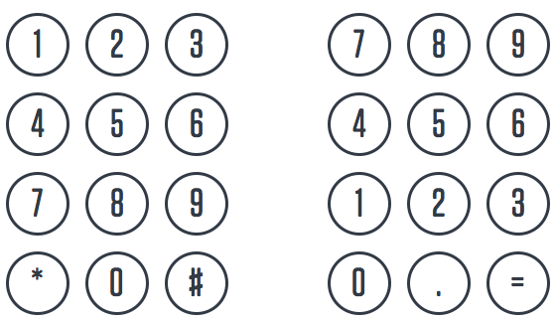
Which is the better UI?
telephones bank machines
calculators computers
Notes:
Neither interface is better. The problem is the other one: there are two "standard" interfaces. If it really was "standard", there would be only one interface.
The telephone grid has since been adopted by any device requiring casual / infrequent use such as bank machines.
The calculator/computer keypad had been around longer. It is the standard for expert / frequent users.
Telephone keypad was established in ~1960 after AT&T did a study to test button interfaces for touch tone dialing which replaced rotary dial pulse dialing.
https://ieeexplore.ieee.org/document/6773609
https://ieeexplore-ieee-org.libaccess.senecacollege.ca/stamp/stamp.jsp?tp=&arnumber=6773609
Why 123 / 456 / 789 / 0 was selected over 789 / 456 / 123 / 0 is due to limited, and perhaps bad, testing methodology. (e.g. apples vs oranges comparisons, comparisons within groups generalized to all groups, ANOVA should have been used in first experiment and was not. E.g. loser in group 1 could have been a winner when compared to items in other groups.)
Subjects in the experiments preferred the two row horizontal arrangement of 12345 / 67890 over the 3x3 grid which was selected based on "engineering advantages." Details of this discernment and the ultimate decision making were not explained in the study.
Although the 3x3 arrangement was chosen, there was no evaluation of the two 3x3 sequences against each other, perhaps because the experimenters noted there was virtually no difference in various performance measurements between the two. That being the case, why introduce a new user interface that had no particular advantage when the arrangement for calculators was already established?
https://uxdesign.cc/a-brief-history-of-the-numeric-keypad-59112cbf4c49
https://thenextweb.com/syndication/2018/12/31/heres-why-telephones-and-calculators-use-different-numeric-keypads/
https://ux.stackexchange.com/questions/16666/why-do-numpads-on-keyboards-and-phones-have-reversed-layouts
https://commons.wikimedia.org/wiki/File:Telephone-keypad2.svg
https://commons.wikimedia.org/wiki/File:Numpad.svg

Slide 13
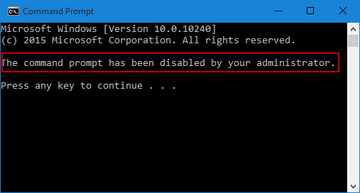
CLI – Command Line Interface
Because rd does not mean Restore Data C:\>rd /s/q .
(don’t do this)
Notes:
The command line is the original computer user interface. It is a simple prompt for the entry of a command by the user and a response from the operating system.
Input from the Command Line is processed by a Command Line Interpreter which parses the command and its parameters, performs the command – subject to security and OS constraints – and outputs information resulting from the CLI input.
What a clean and clear, uncluttered, pure, simple, straightforward, uncomplicated, streamlined, efficient, elegant User Interface! It is all those things but it is not particularly useful unless you are an expert with a very good memory.
To use applications, the user first learned to use the OS.
Today, only administrators use the command line.
CLI is quite powerful but not particularly “user friendly”. Thus, the command line restriction on many corporate users’ PCs.
RD does not mean Restore Data, or Reverse Deletions, Repair Damage, Rebuild Database, or Rectify Difficulties, … it means Remove Directories and Real Disaster.

Slide 14
CLI – Command Line Interface
1 minute BS (brain storm) session
What problems can this UI solve?
Strengths and Opportunities
What problems can this UI create?
Weaknesses and Risks
Notes:
What can go wrong? instead of the painful process of looking up cryptic switches, we think we can remember them. Oops. We think we are right until we know we are wrong…but then it may be too late.

Slide 15
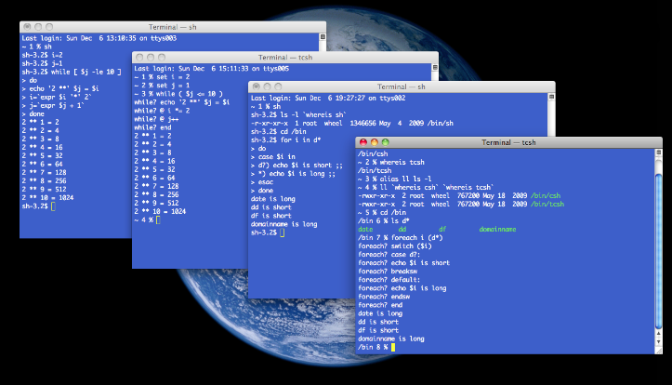
Windows cmd, bash shell on Linux
Fast, unambiguous, easy to document, script-able, macro-able.
Unusable without a manual or a good memory.
Be careful > sudo rm -rf / (don’t do this)
Notes:
RM can mean Really Mucked-up. Command line interface assumes people act perfectly under perfect conditions.
https://aws.amazon.com/s3/
Amazon Simple Storage Service (Amazon S3) is object storage with a simple web service interface to store and retrieve any amount of data from anywhere on the web.
Customers use Amazon S3 as primary storage for cloud-native applications; as a bulk repository, or "data lake," for analytics; as a target for backup & recovery and disaster recovery; and with serverless computing.
How a typo took down S3, the backbone of the internet
http://www.theverge.com/2017/3/2/14792442/amazon-s3-outage-cause-typo-internet-server
https://aws.amazon.com/message/41926/ https://status.aws.amazon.com/
On Feb.28, 2017 at 9:37AM PST [while debugging an issue in the S3 billing system] an authorized S3 team member using an established playbook executed a command which was intended to remove a small number of servers for one of the S3 subsystems that is used by the S3 billing process. [No problem, S3 has a massively redundant architecture.] Unfortunately, one of the inputs to the command was entered incorrectly and a larger set of servers was removed than intended. [This caused a cascading failure in numerous dependent systems causing] each of these systems to require a full restart. …we have not completely restarted the index subsystem or the placement subsystem in our larger regions for many years. S3 has experienced massive growth over the last several years and the process of restarting these services and running the necessary safety checks to validate the integrity of the metadata took longer than expected. … finished recovery at 1:54PM PST. At this point, S3 was operating normally. Other AWS services that were impacted by this event began recovering. Some of these services had accumulated a backlog of work during the S3 disruption and required additional time to fully recover.
https://aws.amazon.com/s3/sla/
“Monthly Uptime Percentage” is calculated by subtracting from 100% the average of the Error Rates from each five minute period in the monthly billing cycle.
8766 = avg number of 5 minute periods in a month (=365.25 days per year * 24 hours per day * 12 five minute periods per hour / 12 months)
51.4 = number of 5 minute periods in 4 hours, 17 minutes of 100% downtime =(4 hours * 60 minutes + 17 minutes ) / 5 minute periods
99.41% uptime qualifies for a 10% service credit – was that enough to compensate your business for 4+ hours of downtime?
$2,000+ is the conservative cost of 4+ hours of downtime for a $1M/year business divided by 2000 hours/year (50 weeks * 40 hrs/wk)
AWS S3 would cost about $10 (ten dollars) a month resulting in a $1 (one dollar) saving for ½ day of downtime. You've only lost $1999 instead of $2000.
See http://www.hostingadvice.com/how-to/aws-s3-pricing/

Slide 16
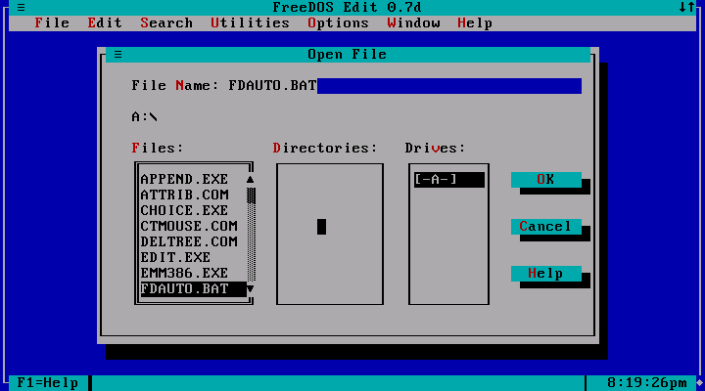
TUI – Textual User Interface for Console Apps
Addressable
25 rows
80 columns
Pull down menus, mouse support,
character graphics symbols
Notes:
"bad user interfaces are a kind of bug that manifests when software runs on people" -- Tonio Loewald (taloewald@ua.edu), Analyst/Programmer at the University of Alabama Libraries.
This was the next evolution from the prompt – response Cmd Line Interface to a full screen text interface.
Why 80 columns? Because punch cards had 80 columns.
A TUI (Text-based User Interface, or Textual UI, or Terminal UI) displayed Extended ASCII graphical characters on an addressable 25 line x 80 character text screen.
Most TUIs accepted mouse and keyboard shortcut inputs. These interfaces were a huge leap forward in making systems much more usable than the simple command line interface. Note the reduction in memory load: you don't have to remember the cryptic command name with its equally cryptic syntax to manage files here. The interface prompts the user as to what to do, the software remembers how to do it.
Replace human memory requirements (knowledge of commands and filenames) with visual information shown on screen.
https://en.wikipedia.org/wiki/Console_application
https://en.wikipedia.org/wiki/Text-based_user_interface

Slide 17
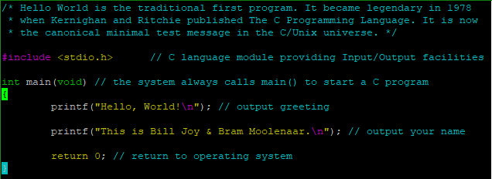

$ vi helloWorld.c Console Application
Notes:
The classic UNIX textual user interface editor known as vi, created by Bill Joy, was replaced by vim (vi improved) by Bram Moolenaar, in 1991, vim current version is 8.1.0000 (17 May 2018)
Vim.org – Vim is a highly configurable text editor for efficiently creating and changing any kind of text. It is included as "vi" with most UNIX systems and with Apple OS X.
Textual console apps are lightweight.

Slide 18
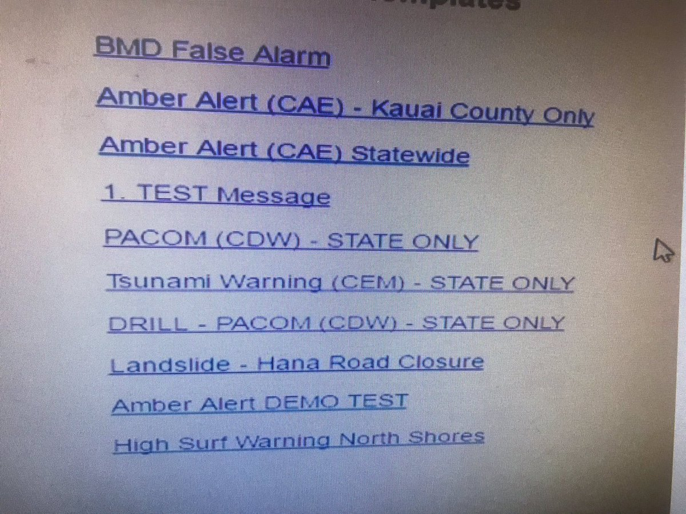
Missile Alert Test
Which line do you click?
Notes:
The screen above is that of the operator in Honolulu who inadvertently issued a ballistic missile alert in the country, when he just wanted to do a test.
https://www.trymyui.com/blog/2018/01/18/how-bad-ux-design-caused-hawaiis-false-missile-scare/
https://www.theverge.com/2018/1/16/16896368/hawaii-false-missile-alert-system-confusing-interface-poor-design
https://www.washingtonpost.com/news/checkpoint/wp/2018/02/17/emails-detail-how-senior-u-s-military-officers-grappled-with-false-hawaii-missile-alert/
https://www.scriptol.com/design/interface.php

Slide 19
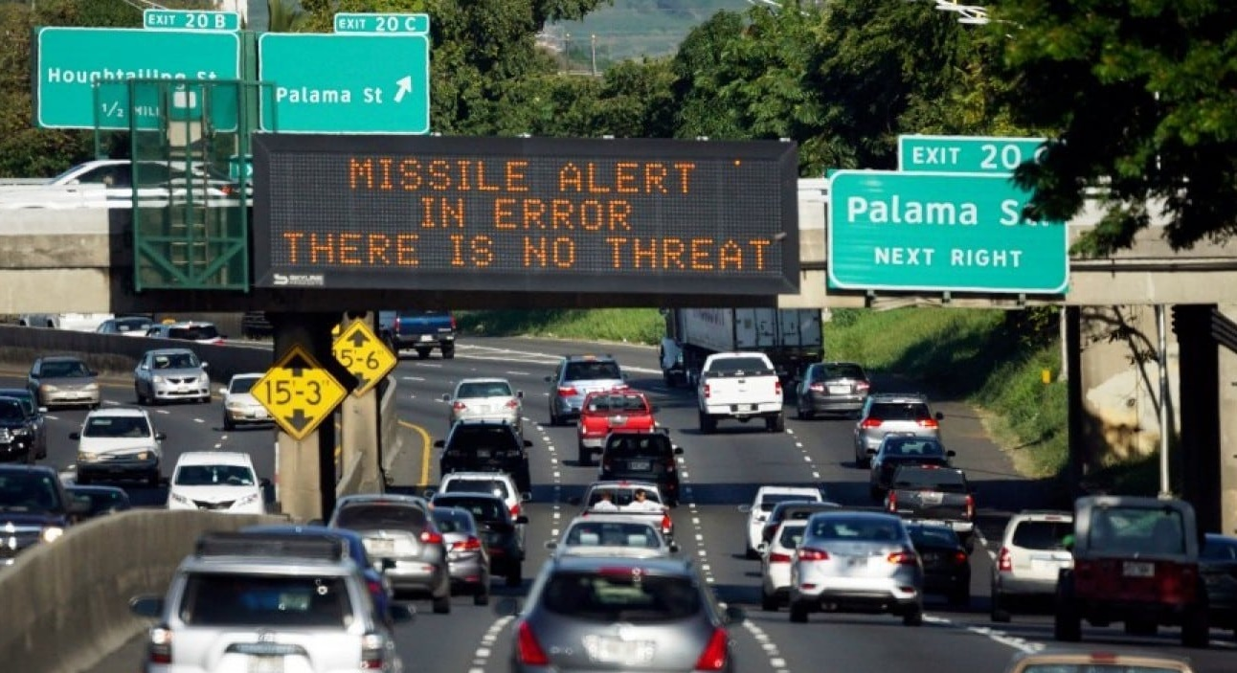
Missile Alert in Error
Notes:
https://www.scriptol.com/design/interface.php
The screen above is that of the operator in Honolulu who inadvertently issued a ballistic missile alert in the country, when he just wanted to do a test. Specifically, he wanted to click on "DRILL - PACOM (CDW) - STATE ONLY" and clicked on "PACOM (CDW) - STATE ONLY". No confirmation request, no possibility to roll back! Moreover, it would have been wise to separate the test orders from the actual orders ...
https://www.trymyui.com/blog/2018/01/18/how-bad-ux-design-caused-hawaiis-false-missile-scare/
https://www.theverge.com/2018/1/16/16896368/hawaii-false-missile-alert-system-confusing-interface-poor-design
https://www.washingtonpost.com/news/checkpoint/wp/2018/02/17/emails-detail-how-senior-u-s-military-officers-grappled-with-false-hawaii-missile-alert/

Slide 20
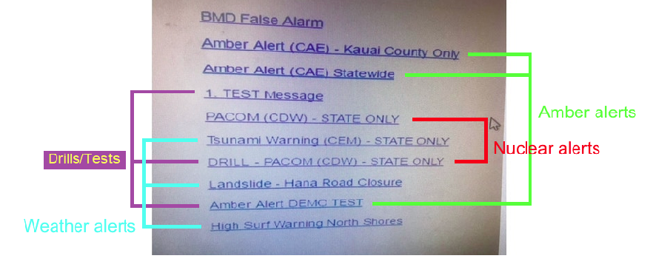
Select an Alert … Good Luck
Notes:
https://www.scriptol.com/design/interface.php
The screen above is that of the operator in Honolulu who inadvertently issued a ballistic missile alert in the country, when he just wanted to do a test. Specifically, he wanted to click on "DRILL - PACOM (CDW) - STATE ONLY" and clicked on "PACOM (CDW) - STATE ONLY". No confirmation request, no possibility to roll back! Moreover, it would have been wise to separate the test orders from the actual orders ...
https://www.trymyui.com/blog/2018/01/18/how-bad-ux-design-caused-hawaiis-false-missile-scare/
https://www.theverge.com/2018/1/16/16896368/hawaii-false-missile-alert-system-confusing-interface-poor-design
https://www.washingtonpost.com/news/checkpoint/wp/2018/02/17/emails-detail-how-senior-u-s-military-officers-grappled-with-false-hawaii-missile-alert/

Slide 21
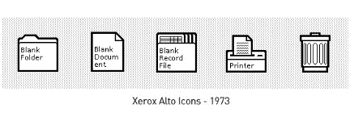
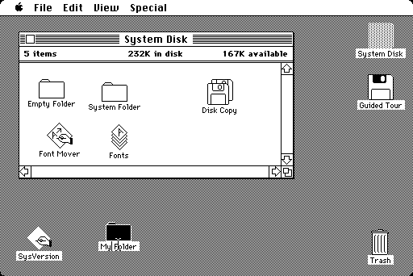
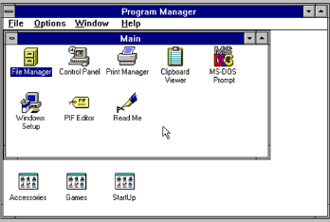
GUI – Graphical User Interface
Notes:
The early GUI from Xerox PARC – Palo Alto Research Center in California. founded in 1970 with the charter to create “The Office of the Future”
The GUIs we see on Windows and Macintosh systems had their genesis in 1973 at PARC on the Xerox Alto personal workstation. The Alto also premiered the WYSIWYG (what you see is what you get) editor.
https://arstechnica.com/cars/2019/02/googles-waymo-risks-repeating-silicon-valleys-most-famous-blunder/ (embedded in this article is the Xerox – Apple story)
Xerox created the GUI in the 1970s and, in 1981, an advanced networking personal computer with GUI apps like word processing and email. The workstation cost $16,595—more than $45,000 in 2019 dollars. It didn't sell.
In 1971, scientists at PARC “modulated a laser to create a bitmapped electronic image on a xerographic copier drum”. In other words, they created the laser printer.
Fifty years in, PARC is not slowing down. Its current focus areas are AI and human-machine collaboration, the digital workplace, novel printing (which includes 3D printing, and flexible electronics – yep – printing circuits is in the cards), Internet of Things and machine intelligence, digital design and manufacturing, and microsystems and smart drives. https://www.parc.com/focus-areas/ai-and-human-machine-collaboration/ https://www.parc.com/focus-areas/digital-workplace/ https://www.parc.com/focus-areas/novel-printing/ https://www.parc.com/focus-areas/novel-printing/ https://www.parc.com/focus-areas/digital-design-and-manufacturing/ https://www.parc.com/focus-areas/microsystems-and-smart-devices/
first print ads for the Macintosh: "On a particularly bright day in Cupertino, California, some particularly bright engineers had a particularly bright idea: Since computers are so smart, wouldn’t it make sense to teach computers about people, instead of teaching people about computers? So it was that those very engineers worked long days and nights and a few legal holidays, teaching silicon chips all about people. How they make mistakes and change their minds. How they refer to file folders and save old phone numbers. How they labor for their livelihoods, and doodle in their spare time."
…as much as humans might learn, they would always be prone to err—and they inevitably brought presuppositions about how things should work to everything they used. This wasn’t something you could teach [out] of existence. In some sense, our limitations and preconceptions are what it means to be human—and only by understanding those presumptions could you design a better world. https://www.wired.com/story/how-dumb-design-wwii-plane-led-macintosh/ and "USER FRIENDLY: How the Hidden Rules of Design Are Changing the Way We Live, Work, and Play" by Cliff Kuang with Robert Fabricant, 2019
Steve Jobs and others at Apple could see that icons would be the new interface on the next generation of Apple computers. In 1979, Xerox showed Apple their GUI ideas in exchange for an option to buy $1M of Apple stock before the IPO.
Apple's first computer with a graphical user interface, the Lisa, was released in 1983 for $9,995 ($25,000 in today's dollars). It didn't sell.
Apple introduced the Macintosh in 1984. (GUI shown above.) Its introductory price of $2,495 ($6,000 in today's dollars) but was seriously underpowered. It didn't sell well. The 1986 version with Apple's laser printer created the "desktop publishing revolution" keeping the Mac alive but in a niche market. Apple computers remained in a niche market for the next 20 years.
Microsoft saw the new Lisa and Macintosh computers from Apple and thought it was a good idea, too. Ironically, Microsoft had a part in keeping Apple alive by developing MS Office for Mac in 1997.
The first people to get rich from GUIs were lawyers when Xerox, Apple, and Microsoft sued each other throughout the 1980s and beyond.
Original Macintosh desktop https://en.wikipedia.org/wiki/File:Apple_Macintosh_Desktop.png

Slide 22
GUI – Graphical User Interface
1 minute BS (brain storm) session
What problems can this UI solve?
Strengths and Opportunities
What problems can this UI create?
Weaknesses and Risks

Slide 23
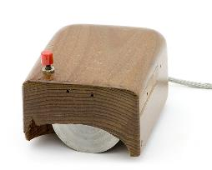
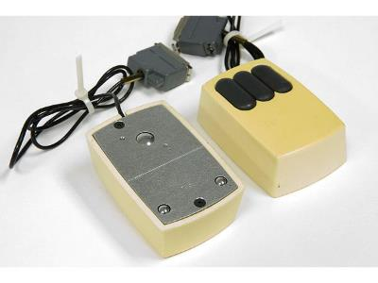
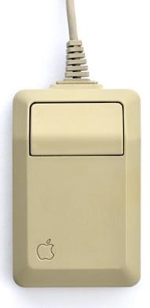
GUI’s enabling tech: Mice + bit mapped screens
Xerox PARC, 1972 $300 2019 $1,832
Apple
Macintosh 1984 $15 2019 $34
Doug Engelbart’s prototype, 1964
Notes:
The mouse was the key invention enabling the GUI. A natural pointing gesture replaced keyboard navigation.
Mouse movements were related to a bit mapped screen as opposed to a text screen with rows and columns of characters
Programming paradigm reminder: "Event-handling is necessitated by the way human-computer interaction works — you’re talking to the analog world, it’s not going to be pretty. The user will do something, it’s generally unrelated to what, if anything, your code was doing. You need to deal with it." Tonio Loewald http://loewald.com/blog/
https://www.techspot.com/guides/477-xerox-parc-tech-contributions/
http://www.computerhistory.org/revolution/input-output/14/350
http://www.computerhistory.org/revolution/input-output/14/350/1545?position=0
https://en.wikipedia.org/wiki/Apple_Mouse
http://www.cultofmac.com/95614/how-steve-jobs-invented-the-computer-mouse-by-stealing-it-from-xerox/
http://dynamis.no/apple-mouse-collection/
https://en.wikipedia.org/wiki/The_Mother_of_All_Demos
Today, touchscreens enable the user to interact directly with what is displayed, rather than using a mouse, touchpad, or any other intermediate device.

Slide 24



GUI versus CLI
Slower but flexible.
Casual users, “User-friendly”
Minimal training. Functions require multiple steps.
Form and Function.
Faster but inflexible.
Administrators experts and only.
Act on many items & objects with a single command.
Function, little Form.
Notes:
Programmer Alert: Good GUI design for expert users includes keyboard shortcuts. E.g. MS-Word and Visual Studio.
No administrator is going to point, click, and edit a thousand user profiles, file permissions, etc.
https://www.interaction-design.org/literature/book/the-encyclopedia-of-human-computer-interaction-2nd-ed/affordances
https://en.wikipedia.org/wiki/History_of_the_graphical_user_interface

Slide 25
Benefits of using GUI
The GUI created end-user computing. Real people (not just geeks and nerds) used computers without extensive training, detailed manuals, or memorization of codes and commands.
The intuitive GUI reduced the ‘barrier to entry’ (command line and text interfaces) allowing broad business deployment of PCs especially for general “Office” applications.
The Iconic Apple 1984 Superbowl ad, PC vs Mac, Macintosh intro characterize CLI vs GUI. The best Apple ad (details).
Notes:
Other enabling technologies, in addition to manual pointing devices like the mouse, were technical developments in the speed and power of CPUs, memory, video processing, and I/O bandwidth (motherboards). The GUI added significant overhead to computer operating systems: from the mid 1980s to mid 1990s, PCs seemed to gain only features, not speed; advances in hardware were used up by software advances in GUIs, OSs, and apps. It took a few years before new PCs with GUIs outperformed old PCs with a text interface.
Event-driven programming concepts came to the personal computer world. It changed the conceptual model of computer systems from structured, procedural coding where, for the most part, the programmer was in control of what the user could do to a collection of event handlers which listened for unpredictable interrupts such as mouse movements and clicks – the PC became a stimulus/response machine instead of a taskmaster. See https://en.wikipedia.org/wiki/Event-driven_programming

Slide 26
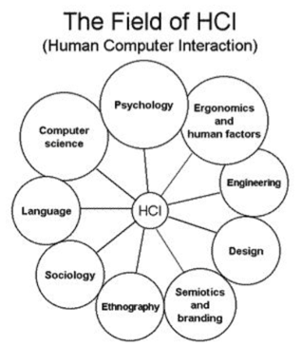
"bad user interfaces are a kind of bug that manifests when software runs on people" -- Tonio Loewal
CLI to TUI to GUI to UX
User eXperience
Notes:
"bad user interfaces are a kind of bug that manifests when software runs on people" -- Tonio Loewald Analyst/Programmer at the University of Alabama Libraries. https://journal.code4lib.org/articles/3107 https://www.linkedin.com/in/tonioloewald http://loewald.com/blog/
Is your GUI “an impenetrable confusion of forms, colours and noises”? See Deiter Rams’s ten principles for good design https://www.vitsoe.com/us/about/good-design
Good design: makes a product useful and understandable, is innovative, unobtrusive, honest, long-lasting, thorough, aesthetic, and uses as little unique design as possible. E.g. the are many ecommerce applications – they have all standardized on putting the shopping cart icon in the upper right corner of the window. The user's account/signon is usually in the same area.
Bells and whistles, features, functions, cool screen widgets, and clever code are the hallmarks of programmers’ egos…done to impress themselves and other programmers. Users suffer the consequences. E.g. make clickable links obvious, like the simple visual affordance of the underline in the good old days. Hiding it, because you are clever enough to know how, turns the major advantage of a GUI—its visual nature—into something worse than a command line interface: it becomes a tedious pixel hunt for features. An empty command line is not particularly user-friendly but at least there is a way to discover its features with manuals and help text. A GUI's hidden features, perhaps to avoid a cluttered interface, are knowable only upon mouse-over. A standard 1920 x 1080 screen contains over 2 million pixels. OK, a clickable item will be at least 10x10 pixels . That's still 20,000 possible That's still a lot of mousing.
In general UX is concerned with how people feel about a system.
value (is it useful?), usability (‘is it easy to use?’), adoptability (is it easy to start using?’), and desirability (is it fun and engaging?’). (Guo, 2012. see http://www.uxmatters.com/mt/archives/2012/04/more-than-usability-the-four-elements-of-user-experience-part-i.php)
https://www.explainxkcd.com/wiki/index.php/2141:_UI_vs_UX
https://www.iso.org/standard/52075.html
ISO (International Standards Organization) 9241-210:2010 provides requirements and recommendations for human-centred design principles and activities throughout the life cycle of computer-based interactive systems. It is intended to be used by those managing design processes, and is concerned with ways in which both hardware and software components of interactive systems can enhance human–system interaction.
https://en.wikipedia.org/wiki/User_experience
https://en.wikipedia.org/wiki/Human%E2%80%93computer_interaction
https://senecacollege-primo.hosted.exlibrisgroup.com/primo-explore/fulldisplay?docid=TN_loughborough2134/15600&context=PC&vid=01SENC&search_scope=default_scope&tab=default_tab&lang=en_US
Using human factors standards to support user experience and agile design
Abstract: The ISO 9241-210 standard provides a framework for human-centred design (HCD) activities comprising the four stages: context of use, specification of user and organisational requirements, design solutions, and evaluation against requirements. Other parts of the 9241 standard cover user interface design and usability. This paper uses the HCD framework to emphasise user experience (UX) design and methods used to help create good user experiences. It also relates the framework to an agile software development environment. It is concluded that the flexible and iterative nature of ISO 9241-210 makes it a good basis for both user experience design and an agile development process.

Slide 27
HCI Human Computer Interaction: CLI to TUI to GUI to UX
GUI led to the study of Human Computer Interaction
User Interface has now become UX User Experience
Is it...useful? easy to use? easy to start using? easy to keep using?
Ergonomics of human-system interaction (ISO 9241-210)
ISO factors that influence user experience: system, user, design, usability, and the context of use.
…because, ultimately, your software runs on the user
See user interface design, information design, and interaction design.
`
Notes:
Is your GUI “an impenetrable confusion of forms, colours and noises”? See Deiter Rams’s ten principles for good design https://www.vitsoe.com/us/about/good-design
Good design: makes a product useful and understandable, is innovative, unobtrusive, honest, long-lasting, thorough, aesthetic, and is as little design as possible.
Bells and whistles, features, functions, cool screen widgets, and clever code are the hallmarks of programmers’ egos…done to impress themselves and other programmers. Users suffer the consequences. E.g. make clickable links obvious, like the simple visual affordance of the underline in the good old days. Hiding it, because you are clever enough to know how, turns the major advantage of a GUI—its visual nature—into something worse than a command line interface: it becomes a tedious pixel hunt for features. An empty command line is not particularly user-friendly but at least there is a way to discover its features with manuals and help text. A GUI's hidden features, perhaps to avoid a cluttered interface, are knowable only upon mouse-over. A standard 1920 x 1080 screen contains over 2 million pixels. That's a lot of mousing.
In general UX is concerned with how people feel about a system.
value (is it useful?), usability (‘is it easy to use?’), adoptability (is it easy to start using?’), and desirability (is it fun and engaging?’). (Guo, 2012. see http://www.uxmatters.com/mt/archives/2012/04/more-than-usability-the-four-elements-of-user-experience-part-i.php)
https://www.explainxkcd.com/wiki/index.php/2141:_UI_vs_UX
https://www.iso.org/standard/52075.html
ISO (International Standards Organization) 9241-210:2010 provides requirements and recommendations for human-centred design principles and activities throughout the life cycle of computer-based interactive systems. It is intended to be used by those managing design processes, and is concerned with ways in which both hardware and software components of interactive systems can enhance human–system interaction.
https://en.wikipedia.org/wiki/User_experience
https://en.wikipedia.org/wiki/Human%E2%80%93computer_interaction
https://senecacollege-primo.hosted.exlibrisgroup.com/primo-explore/fulldisplay?docid=TN_loughborough2134/15600&context=PC&vid=01SENC&search_scope=default_scope&tab=default_tab&lang=en_US
Using human factors standards to support user experience and agile design
Abstract: The ISO 9241-210 standard provides a framework for human-centred design (HCD) activities comprising the four stages: context of use, specification of user and organisational requirements, design solutions, and evaluation against requirements. Other parts of the 9241 standard cover user interface design and usability. This paper uses the HCD framework to emphasise user experience (UX) design and methods used to help create good user experiences. It also relates the framework to an agile software development environment. It is concluded that the flexible and iterative nature of ISO 9241-210 makes it a good basis for both user experience design and an agile development process.

Slide 28
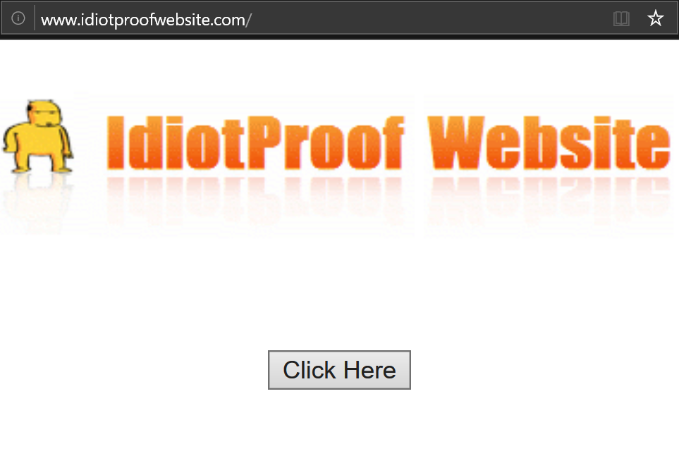
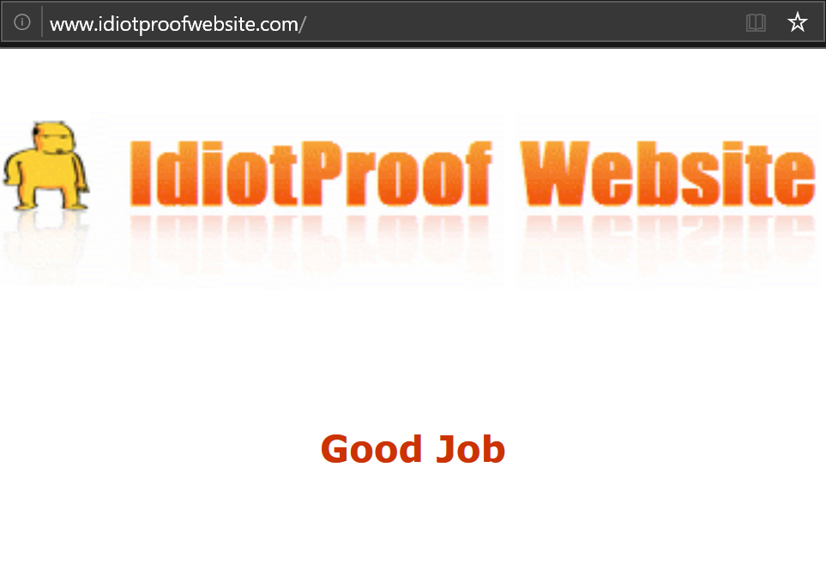
GIGO – Garbage In, Garbage Out
Avoid Garbage In with a good UX and intelligent edits.
http://www.idiotproofwebsite.com/ is as good as it gets.
Validation is the programmer's problem.
Don't fix the user. "idiot-proofing" is solving the wrong problem.
The Problem: seeing the user's POV clearly enough, to understand their objective, and help them get there.
Notes:
[NOTE: this slide makes more sense if viewed in presentation mode.]
Slide text:
Avoid Garbage In with a good UX and intelligent edits.
http://www.idiotproofwebsite.com/ is as good as it gets.
"idiot-proofing" is solving the wrong problem which is trying to fix the user.
The real issue: understanding the problem in enough detail to solve it.
See http://philosophtly.blogspot.com/2009/06/myth-of-idiot-proofing.html
Garbage In, Garbage Out is an axiom of computing. But…
It is impossible to make anything foolproof because fools are so ingenious.
Nothing is foolproof to a sufficiently capable fool.
Make something idiot-proof, and they will build a better idiot.
(https://en.wikiquote.org/wiki/Talk:Murphy%27s_law)
Idiotproof-Website since 2006
http://www.sitepoint.com/forums/showthread.php?444973-Idiotproof-Website

Slide 29
Build a 20 metre Fence
10 × 2 meter fence-boards How many fence-posts?
10 … as a thinking math problem.
11… as a visual building problem.
Notes:
[NOTE: this slide makes more sense if viewed in presentation mode.]
[slide editing note: animation overlays text box at bottom of screen.]
From http://philosophtly.blogspot.ca/2009/06/myth-of-idiot-proofing.html
Make a simple wooden fence twenty metres long. You have ten fence-boards, each two metres long. You go to the lumber mill to get fence-posts -- how many do you need?
This is a user interface error. Many people make the mistake when thinking of it as a math problem: 20m fence = 10 × 2m fence boards = 10 posts.
No one makes this error if they draw the fence with boards and posts. When you draw it and see it, it is an easily solvable building problem.
https://en.wikipedia.org/wiki/Off-by-one_error

Slide 30
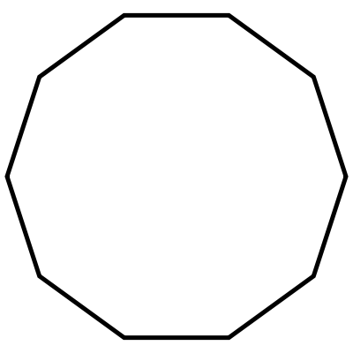
Build a 20 metre Fence
1
10 2
9 3
8 4 7 6 5
Build a fence. – Where?
Around a 6m hole.
– OK, 10 posts.
Notes:
But, 10 posts is the correct number if you understand the problem in enough detail: the purpose of the fence is to encircle a big hole, 6m in diameter.

Slide 31
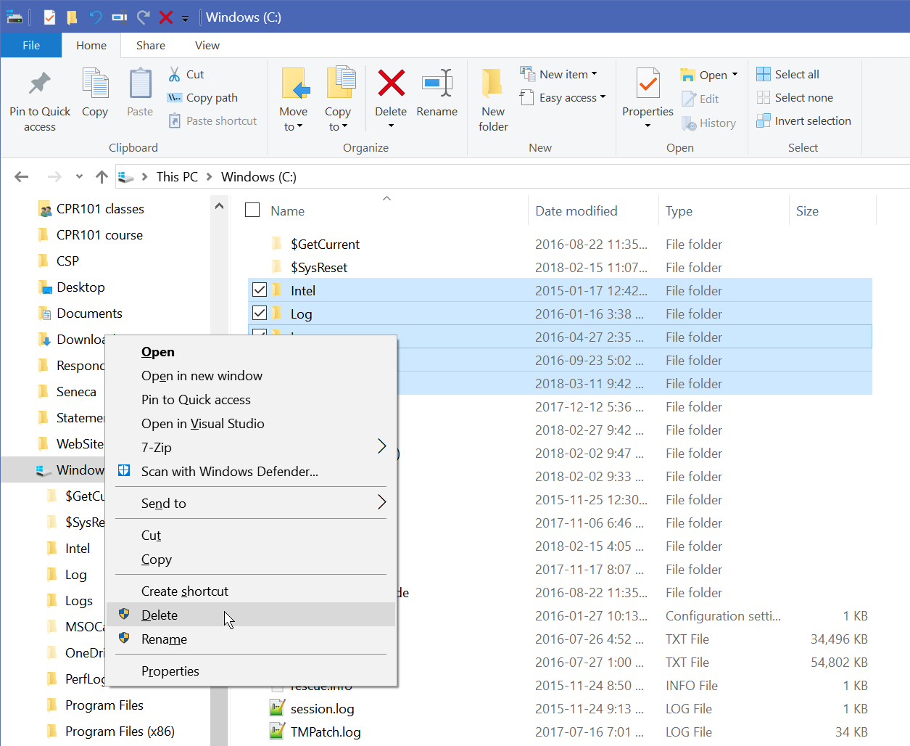
R U sure?
Are you sure about those complex, irreversible actions this dialog is hiding?
Nope, I'm just wasting time.
Go ahead, make my day.
Notes:
Make confirmation dialogs meaningful. Construct the question from the user's POV.
Many inquiry messages are from the system's POV, especially from programmers too lazy to override the button text defaults {OK, Cancel} or where the question needs a double negative response from the user's POV.
e.g. "Confirm you want to cancel your account?" "OK" means "Cancel", and "Cancel" means "cancel the confirmation of the cancellation of my account".
Lab computers warn it is going to sign me off due to inactivity, and I want to stay signed on, but clicked OK. Or was it the other way around? I click the button that seems sensible, but the result is more like flipping a coin.
https://ux.stackexchange.com/
https://ux.stackexchange.com/questions/756/what-are-some-alternatives-to-the-phrase-are-you-sure-you-want-to-xyz-in-confi
https://ux.stackexchange.com/questions/71960/deletion-confirm-or-undo-which-is-the-better-option-and-why
https://developer.microsoft.com/en-us/windows/desktop/design
In Blackboard, the last thing the overtime dialog box says is, "Click Cancel to continue the test."
If the student is getting this message, they are already stressed having run out of time. This is NEVER a good news message.
Often, students in a test are reading quickly and looking for key words, skipping over filler words like "click" – it's a modal dialog with two buttons; what the hell else can you do but click? – and prepositions and articles and conjunctions like and.
The sentence can easily be read as … Cancel … continue ... test – well, who wants to cancel continuing a test? If I wanted to submit the test, I'd bloody well have done that already.
https://ux.stackexchange.com/questions/9946/should-i-use-yes-no-or-ok-cancel-on-my-message-box
https://ux.stackexchange.com/questions/24051/how-to-better-name-modal-buttons-cancel-request-submit-cancel-cancel/35844#35844

Slide 32
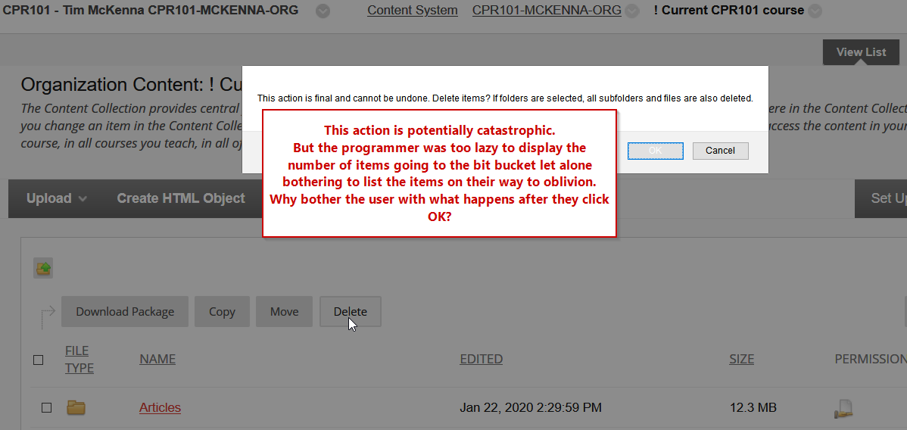
Are you really sure?
Notes:
Make confirmation dialogs meaningful. Construct the question from the user's POV.
This example from Blackboard Learn.

Slide 33
No more ERROR messages…
Issue support, diagnostic, and help messages
Say why the message is issued…not this:
Bad command or filename. [ classic DOS error ]
Input contains invalid character. [ guess which one! ]
Input value out of range. [ guess the min – max ]
Don’t confuse input with output
Why must users format their input 4164915050 the same way their data is output (416)491-5050
Phone numbers, dates – just capture the digits! and format the output
Postal Codes A1B 2C3 may or may not be input with a space.
→ Put messages where users can see them
Notes:
Error → Support, Help, Diagnostic messages
Bad command or filename Abort, Retry, Ignore? Invalid value
https://en.wikipedia.org/wiki/Bad_command_or_file_name
https://en.wikipedia.org/wiki/Abort,_Retry,_Fail%3F
https://uxdworld.com/2018/05/30/how-to-write-good-error-messages/
https://www.google.com/search? q=How+to+Write+Good+Error+Messages
//xkcd.com/1024/ error code
https://xkcd.com/2303/ ERROR TYPES
Dear support people,
This was entered on a new provider set up dialog:
* Phone Number: 6474793519
(xxx-xxx-xxxx)
and this message was received: ** Invalid character in the phone number field. **
I've been in IT business software likely longer than you've been on the planet and this confusion of input with output has got to stop. It annoys users and says nothing good about the professionalism of your software development.
The "xxx-xxx-xxxx" is the OUTPUT format. The INPUT is just what it says, a phone NUMBER. The only invalid characters in the phone number field are the editing characters that the software insists must be entered. How can a phone number possibly contain invalid characters when the only thing entered was digits...you know, numbers.
I seriously doubt the phone number is stored in your DB with output editing characters, formatting, or an edit mask. Unless, that is, your DB people like wasting persistent storage, inflating the size of backups, and slowing your systems with superfluous data being moved around.
Users do not have to format their input 4164915050 the same way the program outputs 416-491-5050. For phone numbers and dates, simply capture the digits, store them, and format the data when it is output. Postal Codes A1B 2C3 may or may not be input with a space – deal with it!
Please, please, please don't blame users for entering a phone number in a way that a programmer does not like. Phone numbers are represented in a variety of ways to humans. A prompt of "Phone (416-555-1234):" is no reason to penalize the user with the "Invalid phone number format" message displayed a long way away from the Submit button. Again, "4165551234" really IS a phone number even though it has no formatting. DO NOT restrict the phone number input field to 10 characters on the HTML form. Some countries have longer phone numbers, some users may input their phone number with editing characters/punctuation/spaces, some may not.
Use some Javascript like [ Phone.replace(/[^0-9]/g, ''); ] to clean out the non-digit characters so it can be stored in the DB. That is the programmer's job, not the user's. Programming should not make users' lives worse instead of better. The way programmers think it is not always the way users think. Forcing users to do it one way – the programmer's way – is just laziness on the part of inconsiderate developers.
Cleanse the user's input when safe to do so. Usually:
* Trim input of leading and trailing blanks TRIM(string)
* Change multiple spaces to single space WHILE " " is found in string, REPLACE " " WITH " "; if REGEX is supported, replace all whitespace WHILE "\s\s" is found in string, REPLACE "\s\s" WITH " "
* Get only the digits ==> return new String(input.Where(Char.IsDigit).ToArray()); or replace all non-digits with empty string, ==> return Regex.Replace(input, @"[^0-9]+", "");
* Always store addresses in UPPER case UPPER(string) because that is the standard for postal and delivery systems around the world.
* Store names in UPPER case.
* Mixed case can be used ONLY IF your DB does case independent searches AND EITHER the end user inputs their name as it will appear OR the software is aware of the many myriad cultural variations in family names.
* N.B. Do NOT prompt a user for First and Last names. First and Last is culturally relative. Sometimes First and Last is GIVEN and FAMILY name, sometimes it is FAMILY and GIVEN name. Prompt for "GIVEN" and "FAMILY" names and, no matter what culture the user comes from, they will likely input it as the programmer expected.
* Do not store numeric edited values.
* Store a postal code in a six character field. Output as LEFT(string,3) & " " & RIGHT(string,3)
* Store a phone number as 10 digits with country code stored separately. Output phone as nnn-nnn-nnnn or (nnn)nnn-nnnn or nnn.nnn.nnnns or whatever the heck you like. Don't make this the user's job upon input.
https://xkcd.com/979/
~~~~~~~~~~~~~~~~~~~~~~~~~~~~~~~~~~~~~~~~~~~~~~~~~~~~~~~~~~~~~~~~~~~~~~~~~~~~~~~~~~~~~
alternate rant...
https://www.sunnet.sunlife.com/GB_MBR/wca/updProviderInfoValidate
Paramedical e-claim
Provider Information
Entry of a 10 digit phone number...
* Phone Number: 4166916661
(xxx-xxx-xxxx)
Generated this erroneous validation message...
** Invalid character in the phone number field. **
1. the message is nowhere near the phone number INPUT field
2. exactly WHAT character was invalid? It is a phone NUMBER field. Numbers were input. Is there an errant digit in position 4? In that case, the message should read, "** An invalid character was not entered in the phone number field. Your entry of all digits in a phone number field does not include the invalid characters that are not part of a phone number. **"
3. don't confuse input with edited/formatted output!
4. check that the Postal Code input accepts either 6 or 3+blank+3 a/n. Do not make people input data in its output edited format or guess which is the one true way to enter a postal code...is it with, or without, the space. Do you feel lucky?
Seneca College has one of the best IT programs anywhere. Please send your programmers to us so we can teach them how not to program like you do.

Slide 34
The Curse of Knowledge
What do you mean you don't know what I mean?
The programmer knows…
the logic in the program and how it makes the application work
how the User Interface works with the programming
The user does not know what the programmer knows.
Do not assume the user knows what you know, no matter how obvious it is to you.
Notes:
Steven Pinker (2014, The Sense of Style ) "the Curse of Knowledge" –"a difficulty in imagining what it is like for someone else not to know something that you know. The curse of knowledge is the single best explanation I know of why good people write bad prose." It applies also to user interfaces.
When you assume, you make an ASS of U and ME
https://getpocket.com/explore/item/the-single-reason-why-people-can-t-write-according-to-a-harvard-psychologist
"Why is so much writing so hard to understand? Why must a typical reader struggle to follow an academic article, the fine print on a tax return, or the instructions for setting up a wireless home network?"
These are questions Harvard psychologist Steven Pinker asks in his book, The Sense of Style: The Thinking Person's Guide to Writing in the 21st Century.
"Every human pastime --music, cooking, sports, art, theoretical physics --develops an argot to spare its enthusiasts from having to say or type a long-winded description every time they refer to a familiar concept in each other's company. The problem is that as we become proficient at our job or hobby we come to use these catchwords so often that they flow out of our fingers automatically, and we forget that our readers may not be members of the clubhouse in which we learned them."

Slide 35

PowerShell Core is the new CMD for Windows – Linux – macOS
Notes:
CMD was the original DOS/Windows command line shell. The command line interpreter was the cmd.exe program
https://www.ghacks.net/2018/01/12/powershell-vs-powershell-core-what-you-need-to-know/
https://docs.microsoft.com/en-ca/powershell/scripting/setup/installing-powershell-core-on-macos?view=powershell-6

Slide 36
PowerShell is the new CMD
PowerShell is a command-line shell and scripting language.
has an Integrated Scripting Environment editor
runs across multiple operating systems: Windows, macOS, Linux
Object-Oriented "cmdlets" have Verb-Noun pair, verb identifies the action and noun identifies the entity or object
e.g. Get-Command [*name*], Get-Help, Set-Location, Copy-Item
backward compatibility with old DOS/Windows CMD commands and some cross-platform compatibility with Linux commands.
Audio/Visual Learning: PowerShell Core
Notes:
PowerShell is a task-based command-line shell and scripting language; it is designed specifically for system administrators and power-users, to rapidly automate the administration of multiple operating systems (Linux, macOS, Unix, and Windows) and the processes related to the applications that run on those operating systems. https://docs.microsoft.com/en-ca/powershell/scripting/powershell-scripting?view=powershell-6
the ISE (Integrated Scripting Environment) is the built-in script editor. It looks like a simple command-line window but has numerous features beyond the traditional command interface
CMD = Command Prompt, also known as cmd.exe or cmd, is the command-line interpreter

Slide 37
PowerShell is the new CMD
PowerShell is for system administrators and programmers to automate tasks and manage a platform.
Scripts control system services and resources.
Scripts configure, manage, and administer the platform.
e.g. Networks, Devices, Users, Active Directory
Scripts access services and resources to support user apps.
e.g. setting runtime environment and controlling procedures in application packages with multiple processes
Notes:
PowerShell is a task-based command-line shell and scripting language; it is designed specifically for system administrators and power-users, to rapidly automate the administration of multiple operating systems (Linux, macOS, Unix, and Windows) and the processes related to the applications that run on those operating systems. https://docs.microsoft.com/en-ca/powershell/scripting/powershell-scripting?view=powershell-6
the ISE (Integrated Scripting Environment) is the built-in script editor. It looks like a simple command-line window but has numerous features beyond the traditional command interface
CMD = Command Prompt, also known as cmd.exe or cmd, is the command-line interpreter

Slide 38
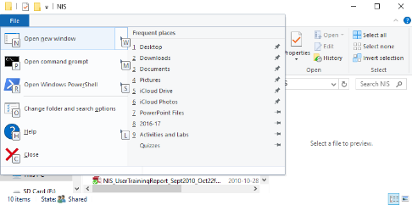
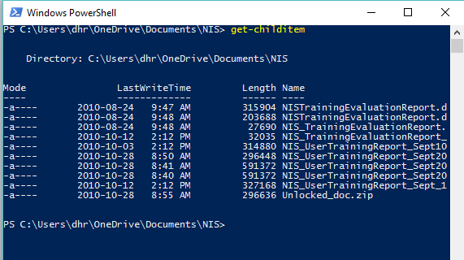
Opening PowerShell from File Explorer
Must navigate to a Folder in File Explorer.
Type ALT + F to open the file menu and then, press R to open PowerShell.
> get-childitem
Here you can see a typical PowerShell window → → →
Notes:
get-childitem without options produces the same output as dir.
It can get the child items of other objects besides the current directory.
Get-ChildItem -Path "C:\Windows\Logs\*"
Get-ChildItem -Path "HKLM:\Software"
https://msdn.microsoft.com/en-us/powershell/reference/5.1/microsoft.powershell.management/get-childitem

Slide 39
Some shortcuts used in PowerShell
These are some of the shortcuts which could be used inside PowerShell:
Arrow Up or Down to recall commands in the stack
Home, End, Ctrl+Arrow Left/Right to edit within the cmd
get-history lists all commands in the stack
get-help
TAB key auto completes, similar to Visual Studio's Intellisense
Cmdlet names
cycles through file names in current folder. Wildcards optional e.g. *.txt [TAB] will retrieve text file names
Notes:
https://technet.microsoft.com/en-us/library/ff678293.aspx

Slide 40
Notes
…not on the quiz but here for further information and explanation.

Slide 41
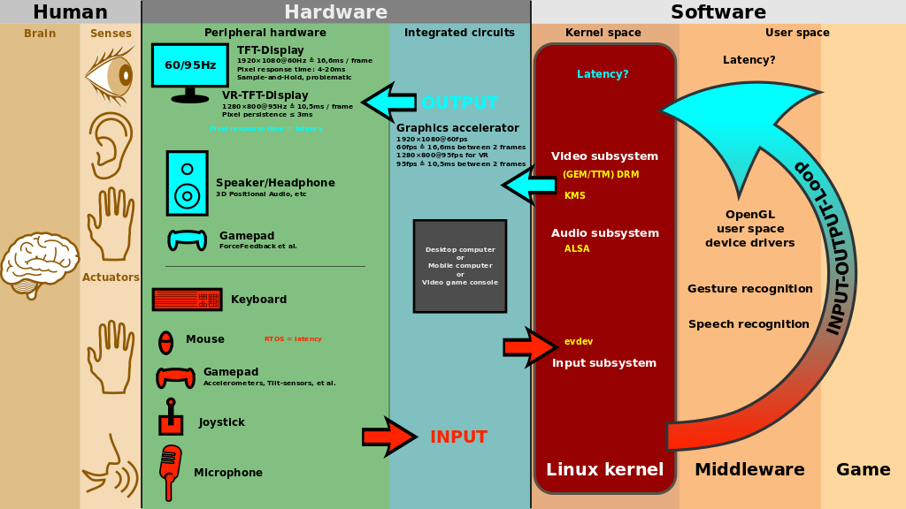
Notes:
The UX is critical for games to be successful. Good games interact with the user via multiple senses.
interactive news – a very different experience from reading the article in a real newspaper
https://www.theglobeandmail.com/report-on-business/how-5g-will-change-your-life/article38009527/
https://www.theglobeandmail.com/news/world/amazon-rainforest-deforestation-crisis/article37722932/
https://upload.wikimedia.org/wikipedia/commons/thumb/a/a1/Linux_kernel_INPUT_OUPUT_evdev_gem_USB_framebuffer.svg/1024px-Linux_kernel_INPUT_OUPUT_evdev_gem_USB_framebuffer.svg.png
Attribution: Shmuel Csaba Otto Traian
https://commons.wikimedia.org/wiki/File:Linux_kernel_INPUT_OUPUT_evdev_gem_USB_framebuffer.svg
From https://en.wikipedia.org/wiki/Human%E2%80%93computer_interaction#Design

Slide 42
one-to-one relationship between PowerShell and File Explorer
There is a one-to-one relationship between the command line and File Explorer, especially in Windows 10.
You can move from one to the other from any folder in Windows and copy any paths.
Learning to take advantage of this feature will greatly improve your speed in programming and using Windows.
Next slides are a few examples of such a relationship.

Slide 43
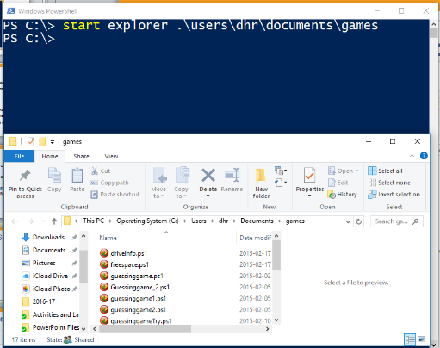
Opening File Explorer from PowerShell
At the Windows PowerShell prompt, type Start Explorer .\ to open File Explorer in the current directory.
You could also pass a directory path to open File Explorer in that path.

Slide 44
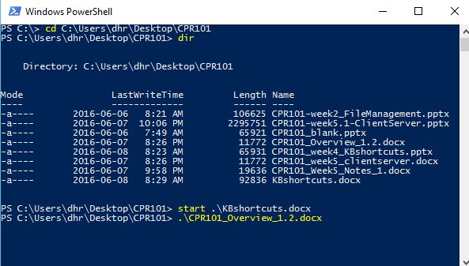
Opening a File or Folder from PowerShell
PowerShell can recall folder and file names in the current directory to the cmd line.
To open a file or folder, type .\ or start .\ then press TAB and cycle through listing (Shift + TAB to go in reverse.)
Stop at a file you want to open and press ENTER; it has the same result as double clicking in File Explorer.
Notes:
e.g.
.\ [TAB]
.\*doc? [TAB]
.\*.ppt? [TAB]

Slide 45
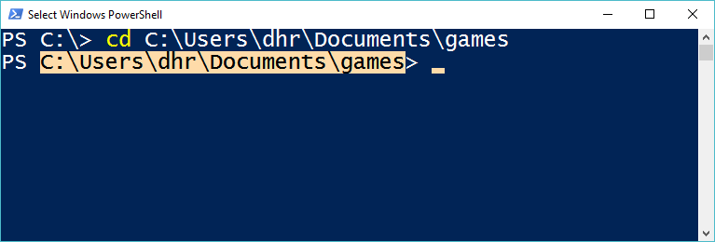
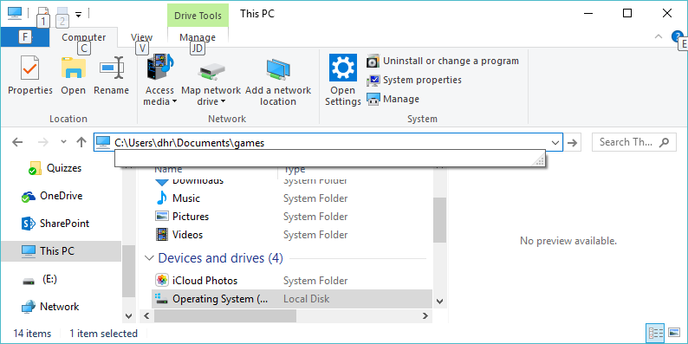
Copying Paths From PowerShell to File Explorer
You can copy paths from PowerShell and paste them into File Explorer. This saves a lot of typing.
To do so, left click at beginning of text and drag mouse to the end of text. This highlights the text.
Then press CTRL + C or the ENTER key to copy to Clipboard.
Right click and select Edit Address in File Explorer, type CTRL + V to paste the new address and press ENTER to move to the directory.

Slide 46
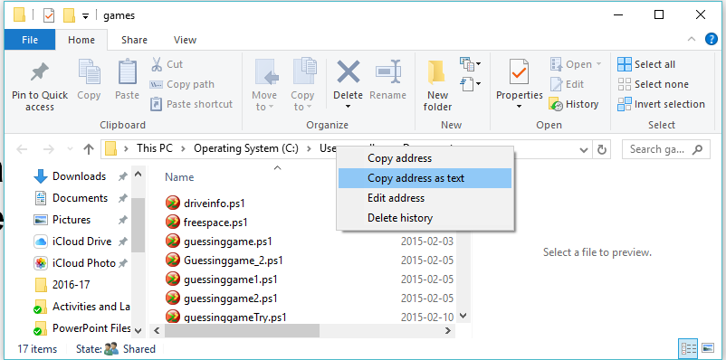
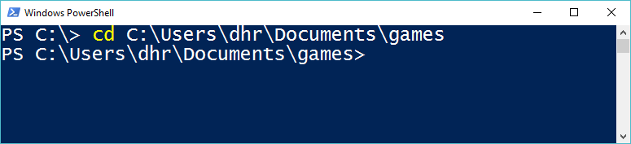
Copying Paths from File Explorer to PowerShell
You can copy paths from File Explorer and paste them into PowerShell as well.
To do so, right click on the address bar in the File Explorer and select copy address as text.
Then, right click in PowerShell and paste after command.

Slide 47
Time Management Definition (trad.)
Time management is the act or process of “planning and exercising conscious control over the amount of time” spent on specific activities, especially to “increase effectiveness, efficiency or productivity.”
Effective time management can help “increase productivity and reduce stress.” By learning and applying some time management skills and techniques, increase your chance “to stay organized, keep a clear mind, and be more productive” (in work, study, and life.)

Slide 48
What is “Command Line Interface” (CLI)?
To use applications, the user first learned to use the OS.
Today, only administrators use the command line.
Early computers: a user would run a command asking the operating system to complete a task. It was a line-by-line, prompt – response.
The most used PC operating system in the 1980s was MS-DOS, Microsoft’s version of the Disk Operating System. This OS used a text prompt relative to a drive (e.g. C:\> ) for entry of commands to execute programs, manage files, and configure the system. Today, see FreeDOS
A CLI (Command Line Interface) is “a user interface to a computer's operating system or an application” in which the user responds to a visual prompt by “typing in a command on a specified line,” receives a response back from the system, and then enters another command, and so forth. (http://searchwindowsserver.techtarget.com/definition/command-line-interface-CLI)
Notes:
https://en.wikipedia.org/wiki/Command-line_interface
Unix and DOS successfully used the CLI for years. E.g.
vi code editor distributed in 1979 with BSD unix

Slide 49
What is “Graphical User Interface” (GUI) and what are some common GUI elements?
A Graphical User Interface (GUI which is sometimes pronounced ‘gooey’) is “a human-computer interface” (i.e., a way for humans to interact with computers) that “uses windows, icons, menus, etc., and which can be manipulated by a mouse and/or touch” (and often to a limited extent by a keyboard as well.) (http://www.linfo.org/gui.html)
GUI Includes all of the graphical elements that we associate with modern computing, such as:
Icons
Menus
Buttons
Mouse cursor
…

Slide 50
A brief history of GUI
There has always been this question that “who invented GUI?” The modern GUI, much like most of modern computing, was invented piecemeal, with many individuals inventing parts that eventually became consolidated into a whole product.
The first organization to really put together the GUI in a working model was Xerox, at their Palo Alto Research Center (Xerox PARC.)
They created the GUI but management could not see how it would be useful for making photocopies.

Slide 51
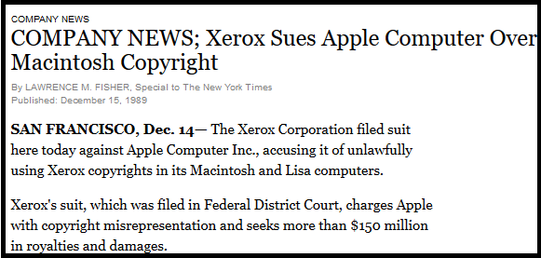
A brief history of GUI (Cont’d) - Early GUI Piracy?
Steve Jobs paid Xerox management in stock to let him and his programmers look at their GUI system.
He and his staff appropriated many of the elements and they became the basis for the Apple Lisa and eventually the Apple Macintosh.
Xerox sued Apple and Apple settled out of court with Xerox.

Slide 52
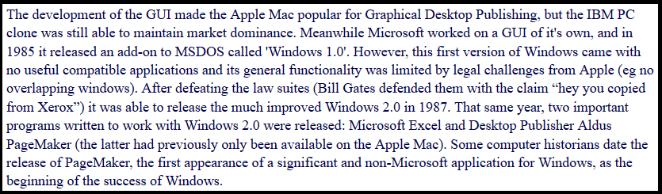
A brief history of GUI (Cont’d) – Microsoft emerges
Bill Gates at Microsoft appropriated these ideas from Apple and used Microsoft’s near-monopoly on the PC market to bring the Windows GUI to end users: (http://www.theoligarch.com/microsoft_vs_apple_history.htm)

Slide 53
CLI and Command Line in Windows
Despite all these facts, there are some cases like network administration or working directly with commands inside configuration files, which using CLI might still be a better and preferred option.
The Command Line (or CMD.EXE) that you access on a modern Windows computer is a clone of MS-DOS which has many limitations (like no networking capabilities, no built-in mouse or other device drivers, no multi-user support, no encryption or security support, etc.)
It’s interesting that when DOS was originally built, these issues were not seen as relevant to the operating system!

Slide 54
CLI and Command Line in Windows (Cont’d)
Due to it’s obvious limitations, the Command Line in Windows fell out of use by most system administrators.
Microsoft realized this and rather than continue to update it, decided to build a new command line and scripting language, on the .NET infrastructure.
The old CMD.EXE command interpreter was planned to be replaced by PowerShell.

